Slide 1
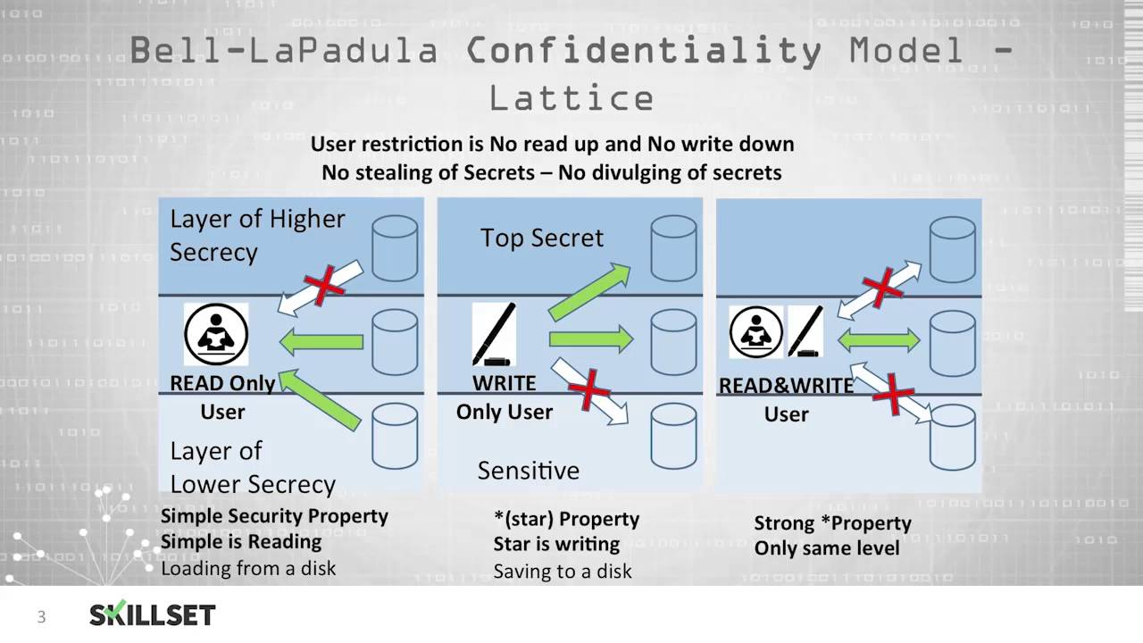
Access Control Policies

Slide 2
Access Control
Access Control is part of nearly every domain in the CISSP, as it’s an integral part of security. In fact, in essence access control is security if we define security as preventing unauthorized access.
Access Control describes a relationship between subjects (people an processes) and objects (computers and data repos.)
Access control is a defensive posture. It puts a perimeter around the subject and sets up a gatekeeper – those allowed come in, those not are kept (or expelled) out.

Slide 3
Access Control Policy – 10 Principles
Least-access: Users should never have access to data they do not need to have access to in order to do their job. There are a lot of situations where someone might have extra access – Maybe they moved from one job to another. Maybe they had temporary duties. Maybe they demanded access because they’re the boss.
Segregation of duties: It’s always a best practice to ensure a user’s duties are not integrated. For example, someone whose position involves submitting purchase orders should also not be allowed to approve purchase orders.
Privileged access: Access should be separated. A staff member with administrator rights to certain assets should not use an administrator account for duties that do not require such access.
Individual accounts: Generic accounts are not a good idea if they can be avoided.

Slide 4
Terms
Authentication –
Identity verification
Authorization –
Passage to security assets and zones based on that identity.
Security principal and security asset –
Authenticated user or computer followed by data repositories and computing resources.
Subjects and objects –
Describe the relationship between security principals and security assets.

Slide 5
Access Control Lists
This is done a number of ways, which comes down to an access control list (ACL) of one type or another.
ACLs are placed on objects, containing a list of subjects and their entitlements to that object.
A similar method that specifies which subjects and objects users or groups can access is called a capability table ​
These specifications are frequently complex matrices, rather than simple lists or tables​
In general, ACLs enable administrations to restrict access according to user, computer, time, duration, or even a particular file

Slide 6
Access Control Lists
In general, ACLs regulate:​
Who can use the system​
What authorized users can access​
When authorized users can access the system​
Where authorized users can access the system from​
How authorized users can access the system​
Restricting what users can access, e.g., printers, files, communications, and applications

Slide 7
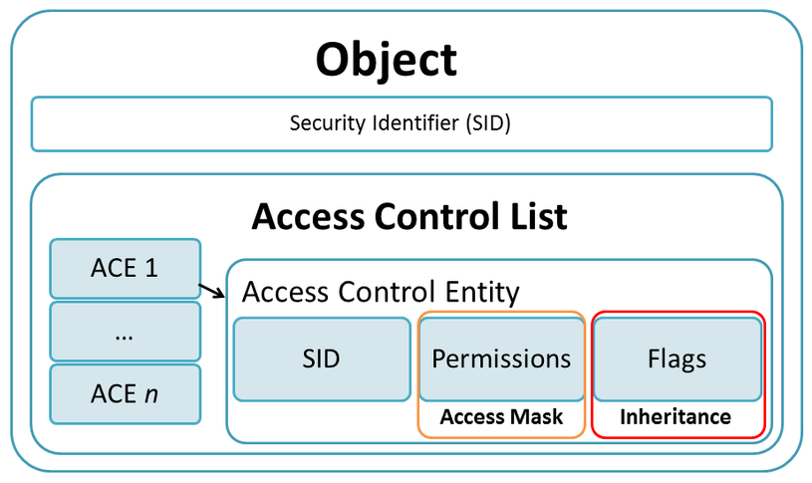

Slide 8
Entitlements
Administrators set user privileges, such as:​
Read​
Write​
Create​
Modify​
Delete​
Compare​
Copy

Slide 9
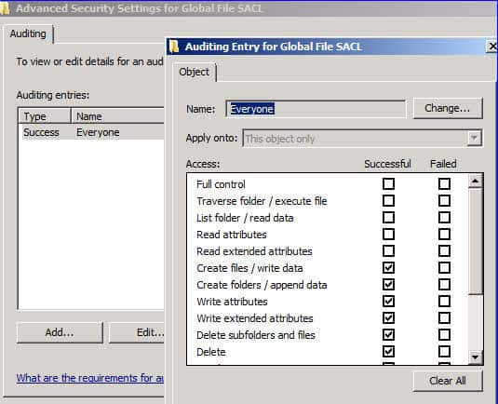
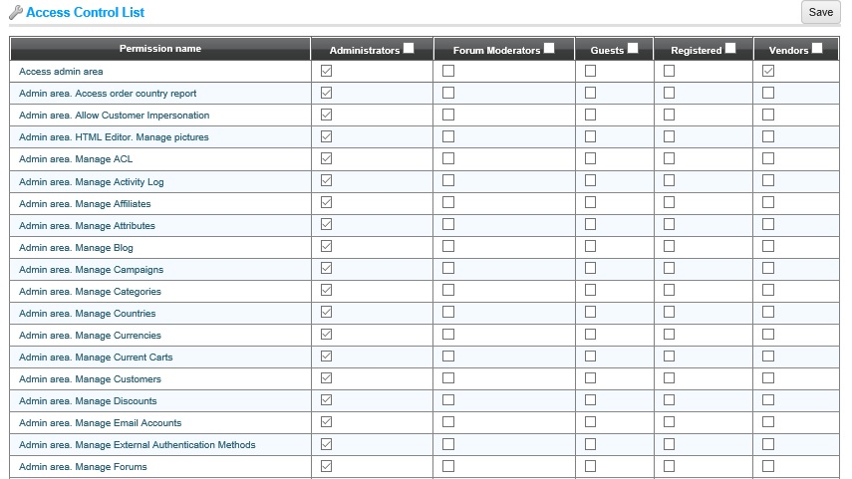

Slide 10
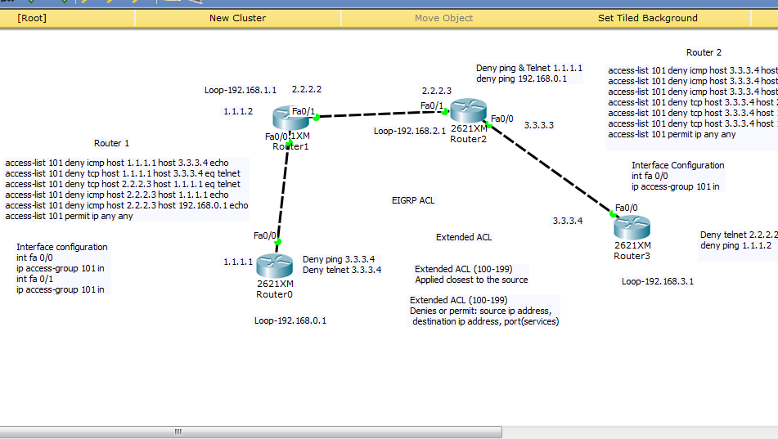

Slide 11
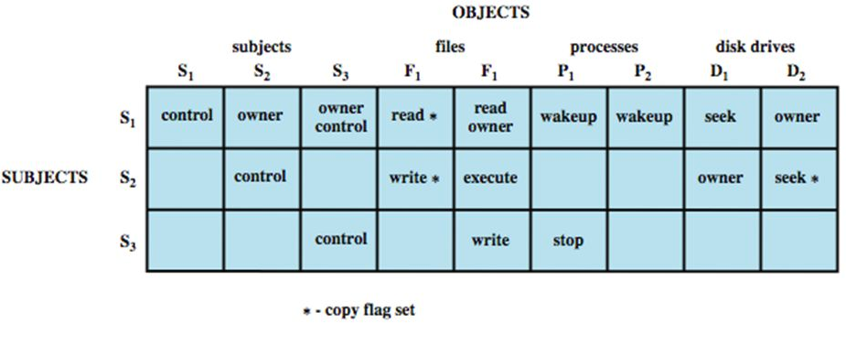
Access control matrix

Slide 12
Interactive Log-On
For computer that is not network member
User supplies logon credentials
Computer validates credentials
Windows Logon credentials
Stored in Security Accounts Manager (SAM) database
Associated with Security IDentifier (SID)
For computer that is member of domain
User authenticated by domain controller
Logon types

Slide 13
Peer-to-Peer Network Logon
Peer-to-peer network
Resources can be shared on any peer
Methods to share resources (Windows, not domain member)
Simple file sharing
No authentication
Guest account used to access resources
User-based access control
User is authenticated
User’s SID determines permissions

Slide 14
Computer Authentication
Some architectures require computer to be authenticated
Active Directory
Domain member must be authenticated by domain controller
Computers assigned SID and password
Automatic computer password managed through Local Security Settings or Group Policy Objects (GPO)
Secure web sites
Server must prove identity to browser when using Secure Sockets Layer (SSL) or Transport Layer Security (TLS) by providing certificate

Slide 15
Mutual Authentication
Requires both parties to provide authentication details
Secure website using SSL or TLS, requiring users to be organization members
Server and client can exchange certificates

Slide 16
Application Authentication
Variety of methods for application authentication
Operating system’s methods
Public central authentication service
Windows Live authentication
Digital certificates
Proprietary method
Applications may also need own credentials or pass user’s credentials for accessing another service

Slide 17
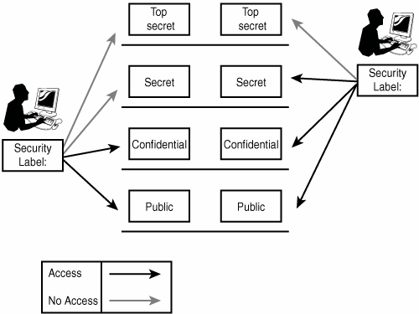
Data classification and protection
Security assets need to be classified and labelled - this is the result of risk analysis and is generally based on the sensitivity of the data, the value of the asset, or the importance of the asset.
Access control policies define how these labels apply to clearances.
A clearance is a formal determination of whether a user can be trusted with a specific level of information. Clearances must determine the subject's current and potential future trustworthiness; the latter is harder (and more expensive) to assess.
Some higher-level clearances include access to compartmented information. Compartmentalization is a technical method for enforcing need to know.

Slide 18
SIDs
SID (security identifier)
SID: S-1-0 Name: Null Authority
SID: S-1-5-2 Name: Network
S-1-5-21-2553256115-2633344321-4076599324-1006
S - string is SID
1 - revision number
5 - authority level (from 0 to 5)
21-2553256115-2633344321-4076599324 - domain or local computer identifier
1006 RID – Relative identifier

Slide 19
SIDs
Authority Level:
0 – Null authority “Nobody”
1 – World Authority, groups like “Everyone”
5 – NT authority
Domain identifier: Corresponds to the domain
Relative identifier:
512, domain admins
501, guest account
500, Admin
18, System
19, LocalService
20, NetworkService
Etc.

Slide 20
Bell-Lapadula – Read down, Write up
The object labels used by many world governments are confidential, secret, and top-secret. This security model is known as Bell-Lapadulla:
“Top Secret” shall be applied to information, of which the unauthorized disclosure could reasonably be expected to cause exceptionally grave damage to national security.
“Secret” shall be applied to information, of which the unauthorized disclosure could reasonably be expected to cause serious damage to national security.
“Confidential” shall be applied to information, of which the unauthorized disclosure could reasonably be expected to cause damage to national security.1
Private sector companies use labels such as “Internal Use Only” and “Company Proprietary” to categorize information.

Slide 21
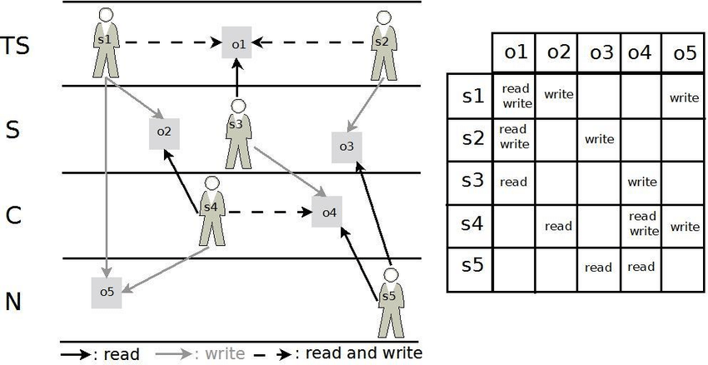
BIBA Model – read up, write down
The inverse of Bell-LaPadula used in corporate structures because where as BLP is for keeping confidentiality, Biba is for maintaining consistency (integrity) in information from the top down.
Biba allows compartmentalization based on reporting structures. Supervisors can read/write with peers. Write to subordinates, who can read that information.

Slide 22
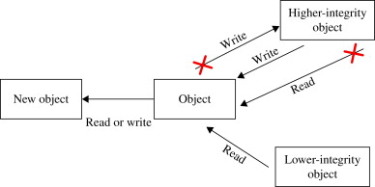

Slide 23
Clark-Wilson Model – Another integrity model
Clark-Wilson is a real-world integrity model that protects integrity by requiring subjects to access objects via programs. The concept of a “well-formed transaction”
Clark-Wilson uses two primary concepts to ensure that security policy is enforced: “well-formed transactions” and separation of duties. The concept of well-formed transactions provides integrity.
The process is comprised of what is known as the access control triple: user, transformation procedure (program), and constrained data item. User to program, program to object.

Slide 24
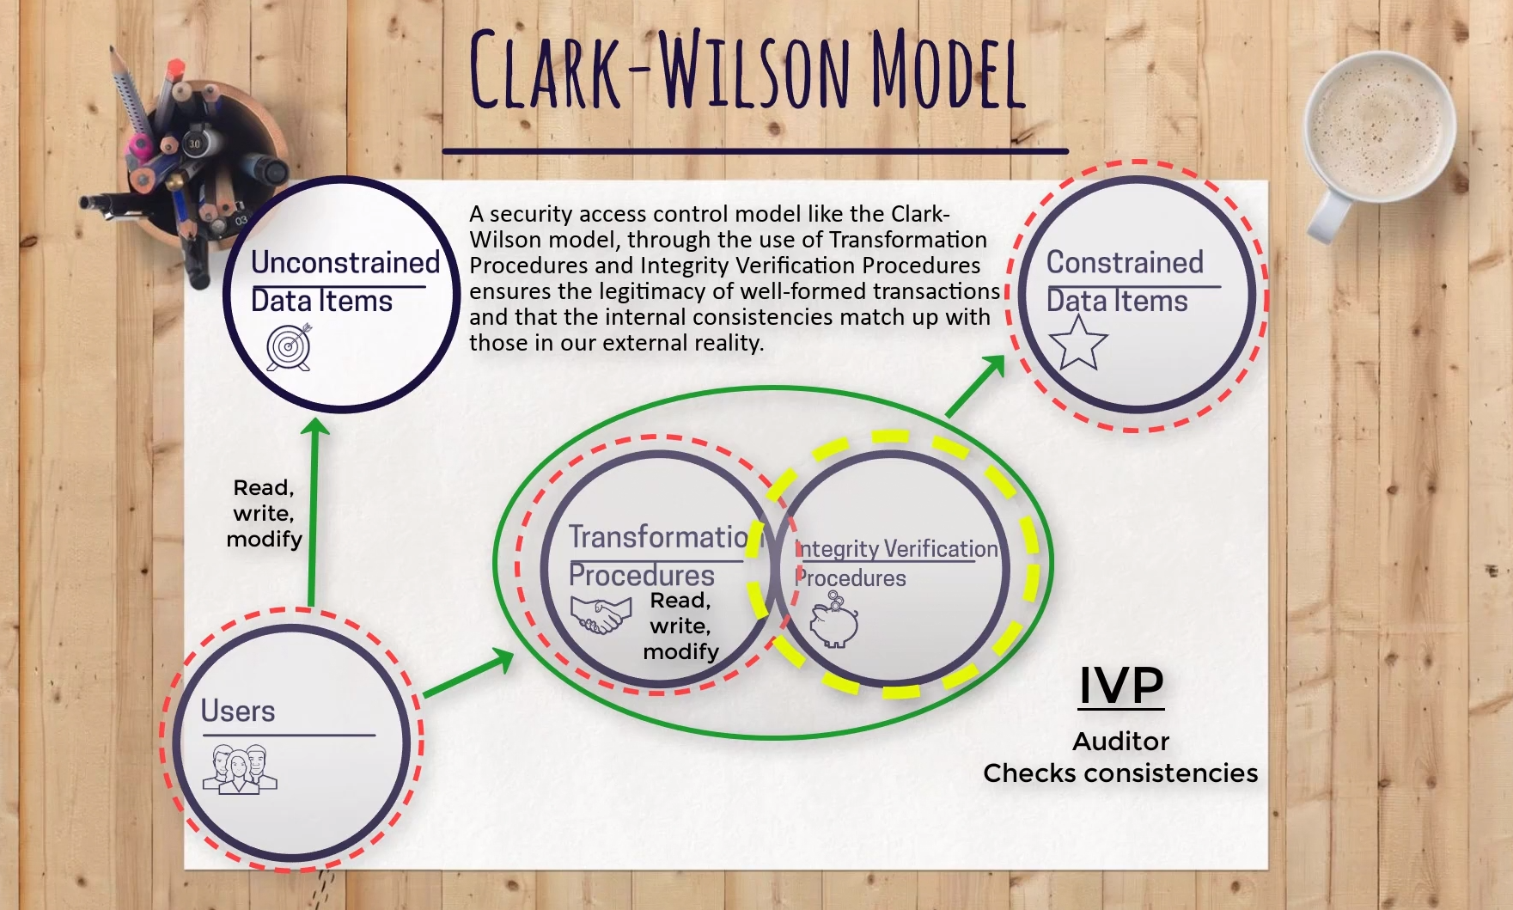

Slide 25

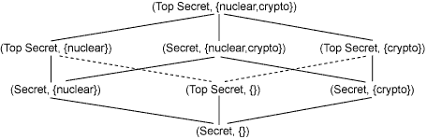
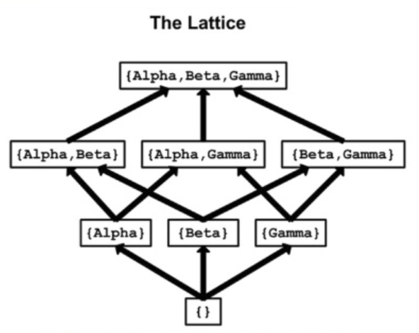
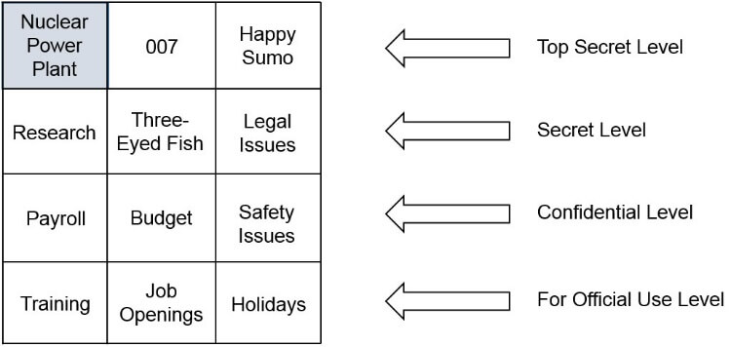
Lattice-Based Controls
Lattice-based access control allows security controls for complex environments.
This lattice, which allows reaching higher and lower data classification, depends on the need of the subject, the label of the object, and the role the subject has been assigned.
Subjects have a least upper bound (LUB) and greatest lower bound (GLB) of access to the objects based on their lattice position.

Slide 26
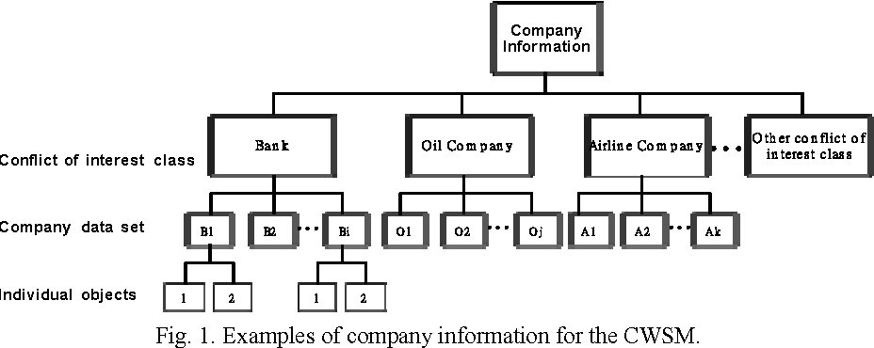
Brewer-nash (Chinese Wall) Controls
The Chinese Wall model (also known as Brewer-Nash) is designed to avoid conflicts of interest by prohibiting one person, such as a consultant, from accessing multiple conflict of interest categories (CoIs).

Slide 27
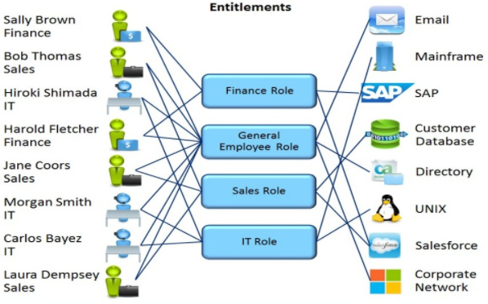
Role Based Access Control (RBAC) or ABAC
Provides access control based on the position an individual fills in an organization.
So, instead of assigning John permissions as a security manager, the position of security manager already has permissions assigned to it. In essence, John would just need access to the security manager profile.

Slide 28
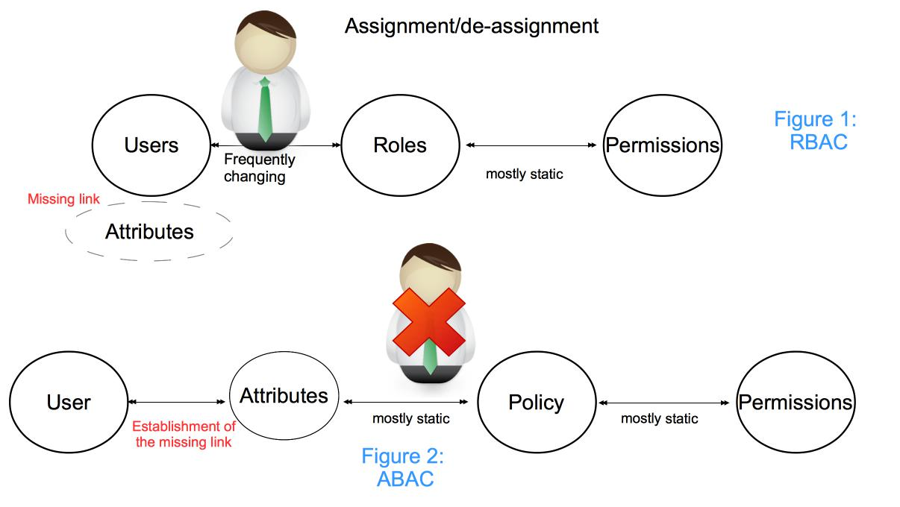

Slide 29
Mandatory Access Control (MAC)
Gives only the owner and custodian management of the access controls.
This means the end user has no control over any settings that provide any privileges to anyone.
There are two security models associated with MAC: Biba and Bell-LaPadula

Slide 30
Discretionary Access Control (DAC)
The least restrictive model compared to the most restrictive MAC model. DAC allows an individual complete control over any objects they own along with the programs associated with those objects.
This gives DAC two major weaknesses. First, it gives the end user complete control to set security level settings for other users which could result in users having higher privileges than they’re supposed to. Secondly, and worse, the permissions that the end user has are inherited into other programs they execute. This means the end user can execute malware without knowing it and the malware could take advantage of the potentially high-level privileges the end user possesses.

Slide 31
Rule-Based Access Control (RB-RBAC)
Will dynamically assign roles to users based on criteria defined by the custodian or system administrator.
For example, if someone is only allowed access to files during certain hours of the day, Rule-Based Access Control would be the tool of choice.
The additional “rules” of Rule-Based Access Control requiring implementation may need to be “programmed” into the network by the custodian or system administrator in the form of code versus “checking the box.”

Slide 32
COmparison
Model | Scalability | Granularity | Sensitivity | Complexity
DAC | ☹ | 😐 | ☹ | 😐
MAC | 😀 | ☹ | 😀 | 😀
RBAC | 😐 | 😀 | 😀 | 😀
ABAC | 😀 | 😀 | 😀 | ☹
RB-RBAC | 😀 | 😐 | 😀 | 😐

Slide 33

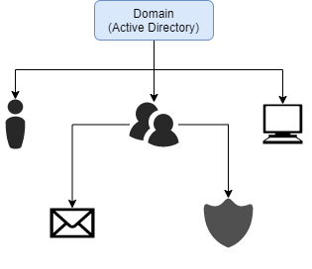
Object Relationships

Slide 34
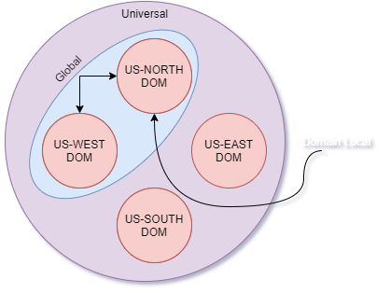
Group Scopes

Slide 35
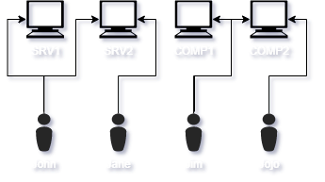
Typography – Flat, Direct

Slide 36
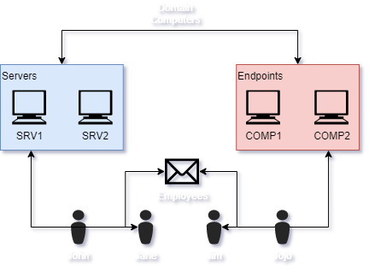
Typography – Flat, Dynamic

Slide 37
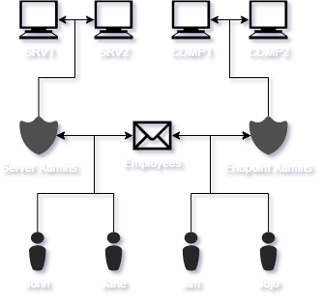
Typography – Stacked, Direct

Slide 38
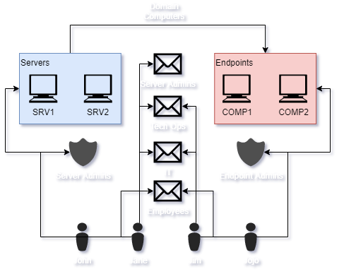
Typography – stacked, Dynamic

